Slide 1
FilmyPro
UI Screens & Workflow
Mod 1: Admin

Slide 2
Admin Login
Create Production
Create Department
Create Sub Department
Create Designation
Add Crew
Define User Rights

Slide 3
Admin Login
Create Production
Create Department
Create Sub Department
Create Designation
Add Crew
Define User Rights

Slide 4
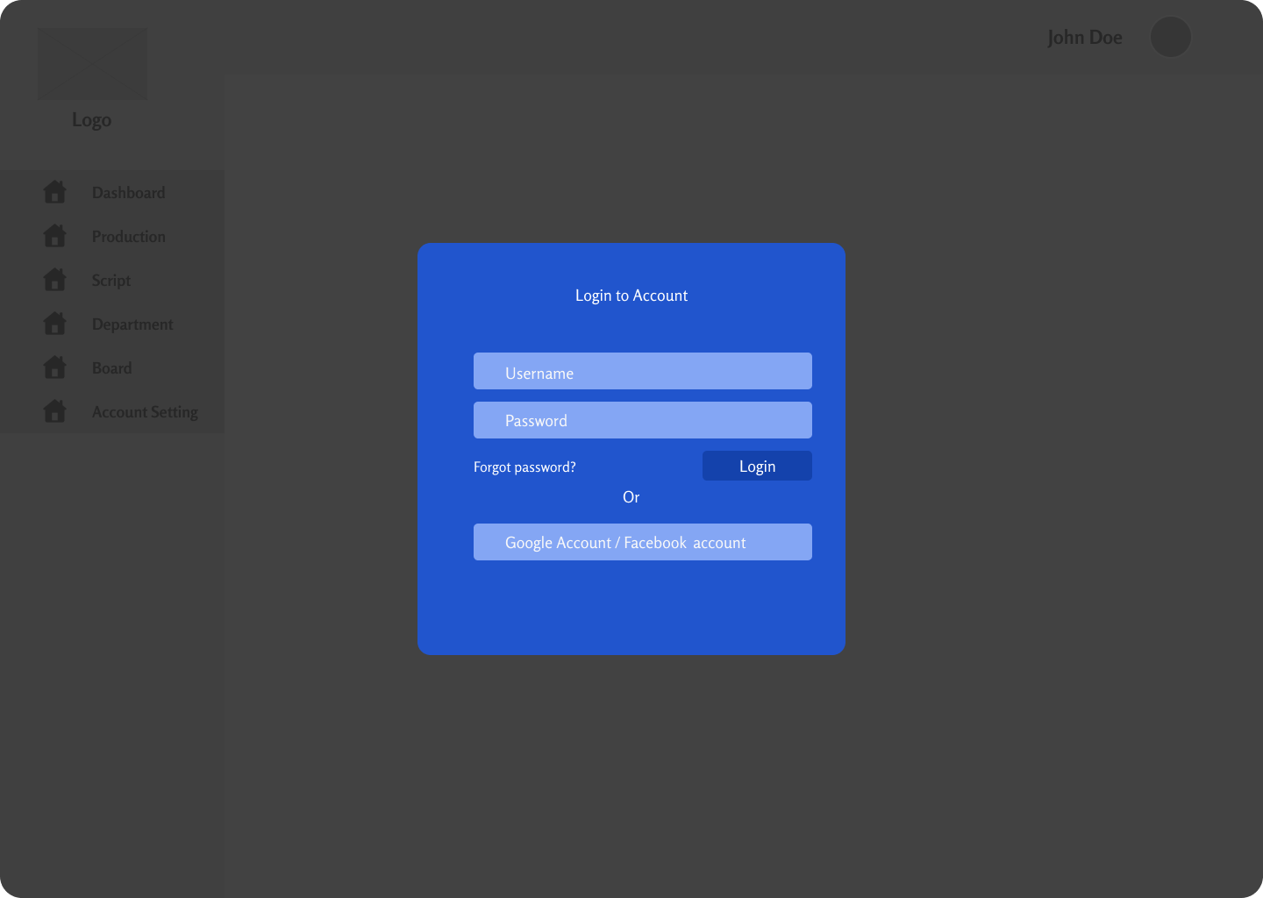


Slide 5
Enter your registered email or mobile number to restore password
Registered email / mobile number

Slide 7
Admin Login
Create Production
Create Department
Create Sub Department
Create Designation
Add Crew
Define User Rights

Slide 8
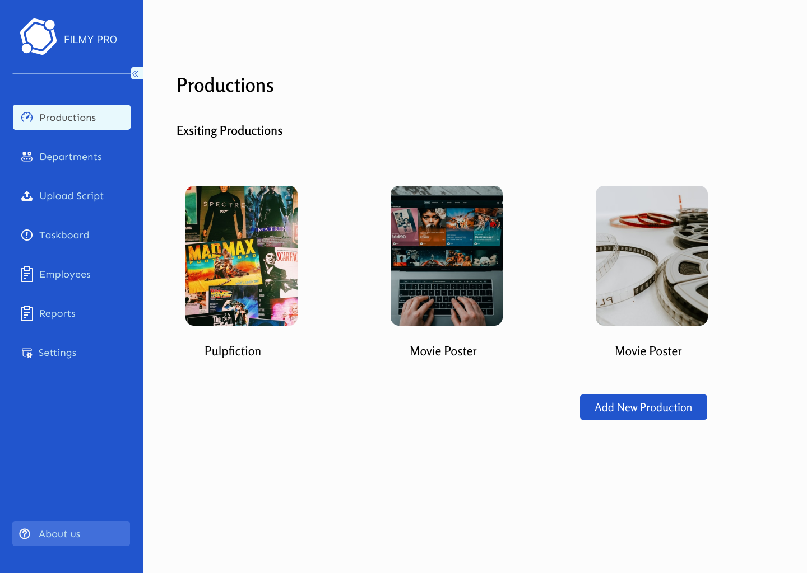

Slide 9
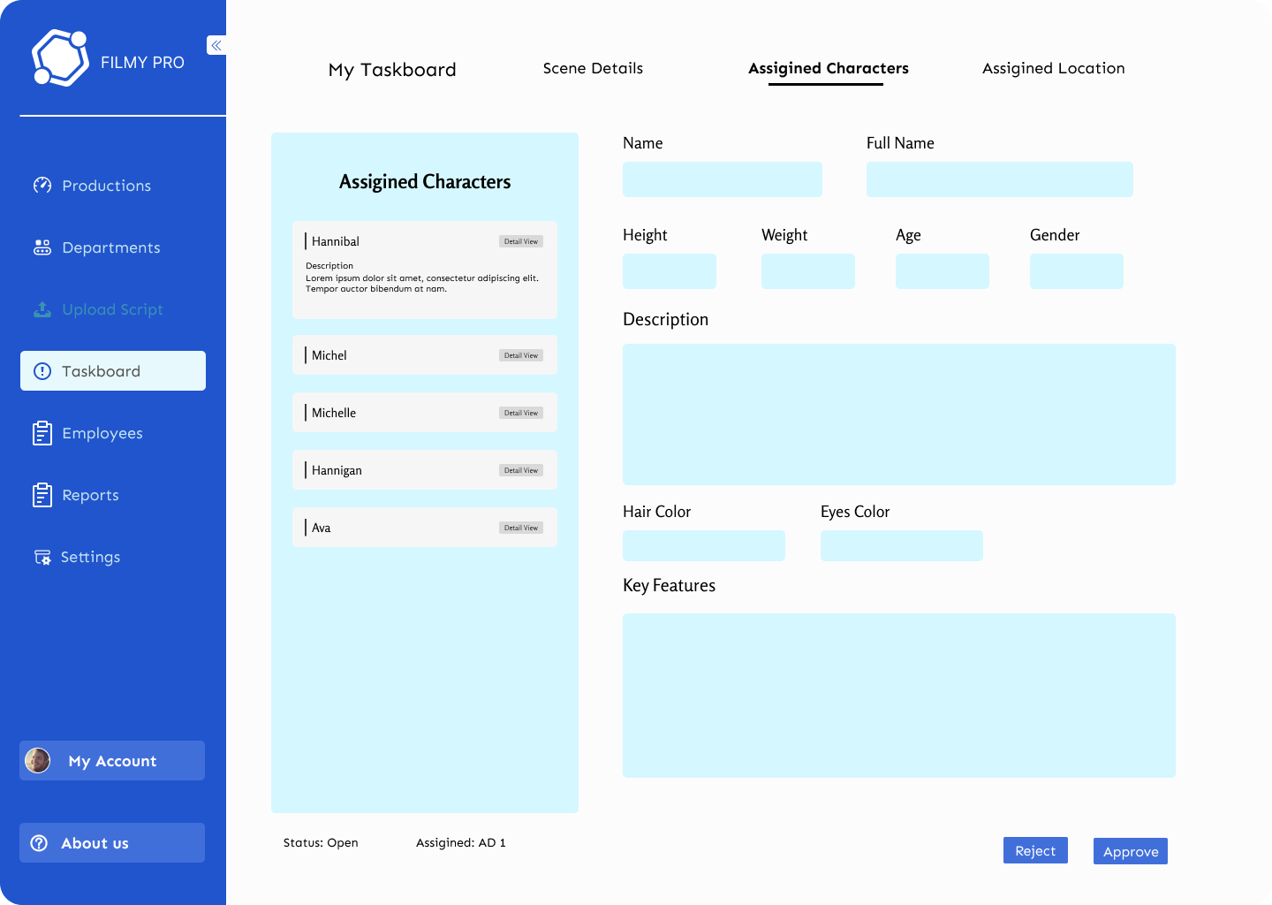
Add Production
Add Image
Production Name
Type of Production
Submit

Slide 10

Add Production
Add Image
Production Name
Type of Production
Submit

Slide 11
Add Production
Add Image
Production Name
Type of Production
Feature Film
Short Film
Commercial
TV Series
Documentary
Corporate Film
Web Series
Episode
News Cast
Stage Production
Mini Series
Clip
Submit

Slide 12
Add Production
Add Image
Production Name
Type of Production
Submit

Slide 13
Top Gun

Slide 14
Admin Login
Create Production
Create Department
Create Sub Department
Create Designation
Add Crew
Define User Rights

Slide 15
Top Gun

Slide 16
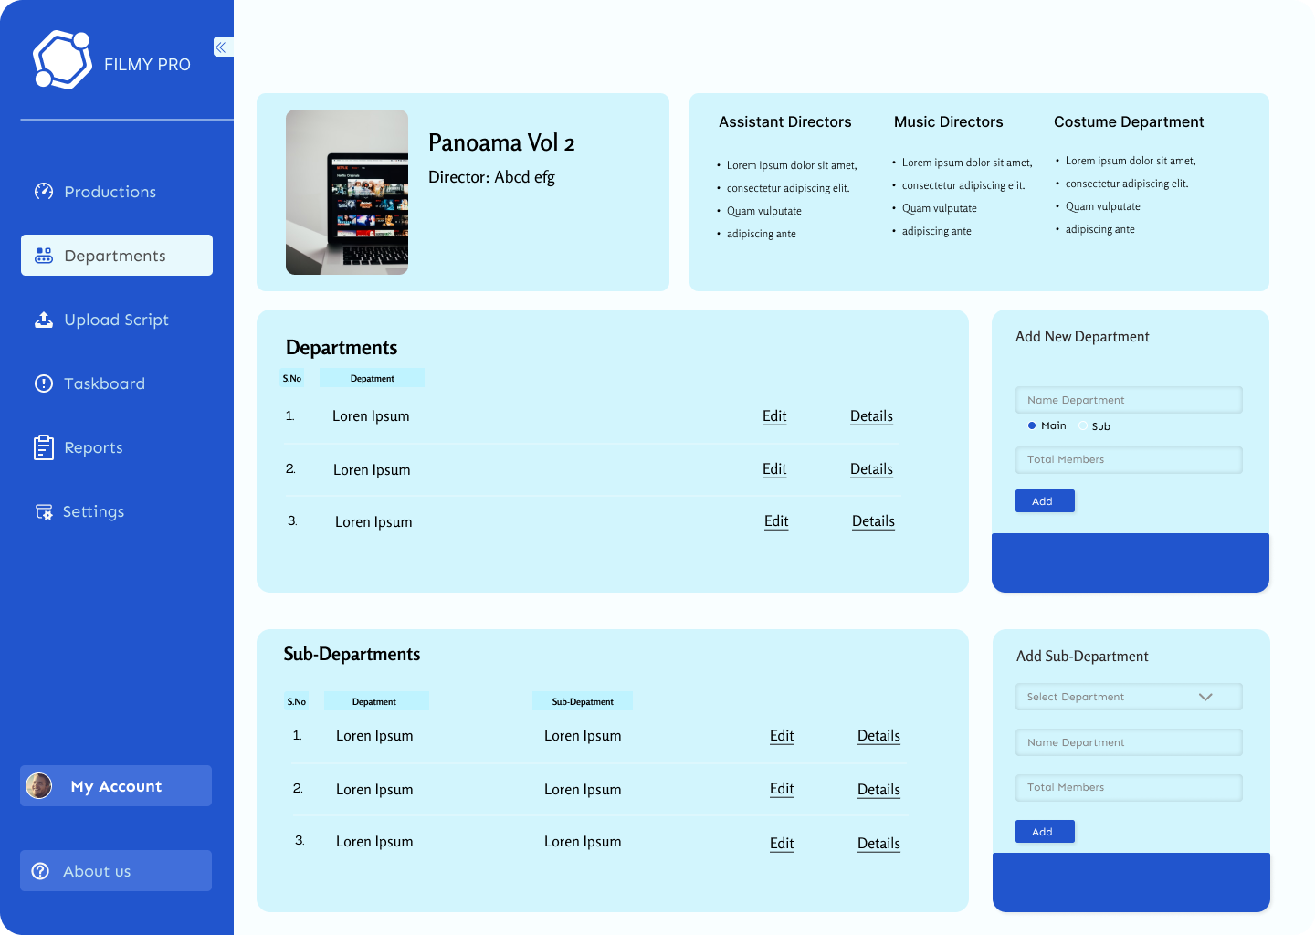
Top Gun
Crew
Upload Script
Setup
Search
Schedule
Reports
Settings
Crew

Slide 17
Top Gun
Crew
Departments
Designations
Add Crew
Assign Rights
Upload Script
Setup
Search
Schedule
Reports
Settings
Crew

Slide 18
Crew
Departments
Designations
Add Crew
Assign Rights
Upload Script
Setup
Search
Schedule
Reports
Settings

Slide 19
Admin Login
Create Production
Create Department
Create Sub Department
Create Designation
Add Crew
Define User Rights

Slide 20
Top Gun
Crew
Departments
Designations
Add Crew
Assign Rights
Upload Script
Setup
Search
Schedule
Reports
Settings
Top Gun
Crew
Crew
Departments
Designations
Add Crew
Assign Rights

Slide 21
Admin Login
Create Production
Create Department
Create Sub Department
Create Designation
Add Crew
Define User Rights

Slide 22
Top Gun
Crew
Departments
Designations
Add Crew
Assign Rights
Upload Script
Setup
Search
Schedule
Reports
Settings
Crew

Slide 23
Direction
Camera and Lighting
Top Gun
Crew
Departments
Designations
Add Crew
Assign Rights
Upload Script
Setup
Search
Schedule
Reports
Settings
Crew

Slide 24
Direction
Direction Team
Top Gun
Locations
Crew
Departments
Designations
Add Crew
Assign Rights
Upload Script
Setup
Search
Schedule
Reports
Settings
Camera and Lighting
Crew

Slide 25
Direction
Direction Team
Top Gun
Director
Crew
Departments
Designations
Add Crew
Assign Rights
Upload Script
Setup
Search
Schedule
Reports
Settings
First AD
Crew
Second AD
Add New
Locations
Camera and Lighting

Slide 26
Direction
Camera and Lighting
Top Gun
Crew
Departments
Designations
Add Crew
Assign Rights
Upload Script
Setup
Search
Schedule
Reports
Settings
Crew

Slide 27
Direction
Camera and Lighting
Top Gun
Photography
Crew
Departments
Designations
Add Crew
Assign Rights
Upload Script
Setup
Search
Schedule
Reports
Settings
Lighting
Crew

Slide 28
Direction
Camera and Lighting
Top Gun
Photography
Crew
Departments
Designations
Add Crew
Assign Rights
Upload Script
Setup
Search
Schedule
Reports
Settings
DOP
Crew
Camera Operator
Add New
Lighting

Slide 29
Admin Login
Create Production
Create Department
Create Sub Department
Create Designation
Add Crew
Define User Rights

Slide 30
Top Gun
Crew
Departments
Designations
Add Crew
Assign Rights
Upload Script
Setup
Search
Schedule
Reports
Settings
Crew

Slide 31

Department
Sub-Department
Designation
Crew
Departments
Designations
Add Crew
Assign Rights
Upload Script
Setup
Search
Schedule
Reports
Settings
Bulk Upload

Slide 32
Department
Sub-Department
Designation
Top Gun
Crew
Departments
Designations
Add Crew
Assign Rights
Upload Script
Setup
Search
Schedule
Reports
Settings
Crew
Bulk Upload

Slide 33
Department
Sub-Department
Designation
Direction
Camera & Lighting
Sound
Production
Art
Costume
Top Gun
Crew
Departments
Designations
Add Crew
Assign Rights
Upload Script
Setup
Search
Schedule
Reports
Settings
Crew
Bulk Upload

Slide 34
Department
Sub-Department
Designation
Camera & Lighting
Top Gun
Crew
Departments
Designations
Add Crew
Assign Rights
Upload Script
Setup
Search
Schedule
Reports
Settings
Crew
Bulk Upload

Slide 35
Department
Sub-Department
Designation
Camera & Lighting
Camera
Lighting
Grip
Top Gun
Crew
Departments
Designations
Add Crew
Assign Rights
Upload Script
Setup
Search
Schedule
Reports
Settings
Crew
Bulk Upload

Slide 36
Department
Sub-Department
Designation
Camera & Lighting
Camera
Top Gun
Crew
Departments
Designations
Add Crew
Assign Rights
Upload Script
Setup
Search
Schedule
Reports
Settings
Crew
Bulk Upload

Slide 37
Department
Sub-Department
Designation
Camera & Lighting
Camera
DOP
Camera Operator
Camera Assistant
Sec Cam Assistant
Steadicam Operator
Focus Puller
Top Gun
Crew
Departments
Designations
Add Crew
Assign Rights
Upload Script
Setup
Search
Schedule
Reports
Settings
Crew
Bulk Upload

Slide 38
Department
Sub-Department
Designation
Camera & Lighting
Camera
Camera Operator
Top Gun
Crew
Departments
Designations
Add Crew
Assign Rights
Upload Script
Setup
Search
Schedule
Reports
Settings
Employee Master
Account Details
Crew
Crew ID |  | Crew Name
Gender | Male/Female/Others | Reporting Crew
DOB | Calendar | DOJ | Calendar
Band |  | Grade
Address |  | Contact (Call)
Whatsapp |  | Email ID
Add
Cancel
Search Database
Bulk Upload

Slide 39
Department
Sub-Department
Designation
Camera & Lighting
Camera
Camera Operator
Top Gun
Crew
Departments
Designations
Add Crew
Assign Rights
Upload Script
Setup
Search
Schedule
Reports
Settings
Employee Master
Account Details
Crew
Name |  | Account Number
Bank Name |  | IFSC Code
PAN No |  | Payment Type | Select Dropdown
Add
Cancel
Other Fields: (For future development)
Photo, Qualification, Languages Known, Special Skill, Previous Experience, Upload of blank cheque with maker checker (accounts module), Special Requirements
Search Database
Bulk Upload

Slide 40
Admin Login
Create Production
Create Department
Create Sub Department
Create Designation
Add Employee
Define User Rights

Slide 41
Top Gun
Crew
Departments
Designations
Add Crew
Assign Rights
Upload Script
Setup
Search
Schedule
Reports
Settings
Crew
Bulk Upload

Slide 42

Search Crew
Top Gun
Crew
Departments
Designations
Add Crew
Assign Rights
Upload Script
Setup
Search
Schedule
Reports
Settings
Crew
ID | Name | Dept | Sub Dept | Designation
21 | Rama | Direction | Direction | AD2
22 | Krishna | Direction | Casting | AD5
23 | Shiva | Camera | Camera | Focus Puller
25 | Deva | Art | Sets | Assistant
26 | Venu | Art | Paintings | Junior
Bulk Upload

Slide 43
Search Crew
Top Gun
Crew
Departments
Designations
Add Crew
Assign Rights
Upload Script
Setup
Search
Schedule
Reports
Settings
Crew
ID | Name | Dept | Sub Dept | Designation
21 | Rama | Direction | Direction | AD2
22 | Krishna | Direction | Casting | AD5
23 | Shiva | Camera | Camera | Focus Puller
25 | Deva | Art | Sets | Assistant
26 | Venu | Art | Paintings | Junior
Bulk Upload

Slide 44

Search Crew
Top Gun
Name:
Designation:
Department:
Crew
Departments
Designations
Add Crew
Assign Rights
Upload Script
Setup
Search
Schedule
Reports
Settings
Krishna
Crew
AD5
Direction
Module | Read | Work | Edit
Mod1
Mod2
Mod3
Mod4
Submit
Bulk Upload

Slide 45
FilmyPro
UI Screens & Workflow
Mod 2.1: Director Setup Pages

Slide 46
Director Login
Verify Crew
Upload Script
Assign Scene Setup
Assign Character Setup
Assign Location Setup

Slide 47
Director Login
Verify Crew
Upload Script
Assign Scene Setup
Assign Character Setup
Assign Location Setup

Slide 49
Top Gun

Slide 50
Director Login
Verify Crew
Upload Script
Assign Scene Setup
Assign Character Setup
Assign Location Setup

Slide 51
Top Gun
Crew
Upload Script
Setup
Search
Schedule
Reports
Settings
Crew

Slide 52
Search Crew
Top Gun
Crew
Upload Script
Setup
Search
Schedule
Reports
Settings
Crew
ID | Name | Dept | Sub Dept | Designation | Edit
21 | Rama | Direction | Direction | AD2 | Edit
22 | Krishna | Direction | Casting | AD5 | Edit
23 | Shiva | Camera | Camera | Focus Puller | Edit
25 | Deva | Art | Sets | Assistant | Edit
26 | Venu | Art | Paintings | Junior | Edit

Slide 53
Director Login
Verify Crew
Upload Script
Assign Scene Setup
Assign Character Setup
Assign Location Setup

Slide 54
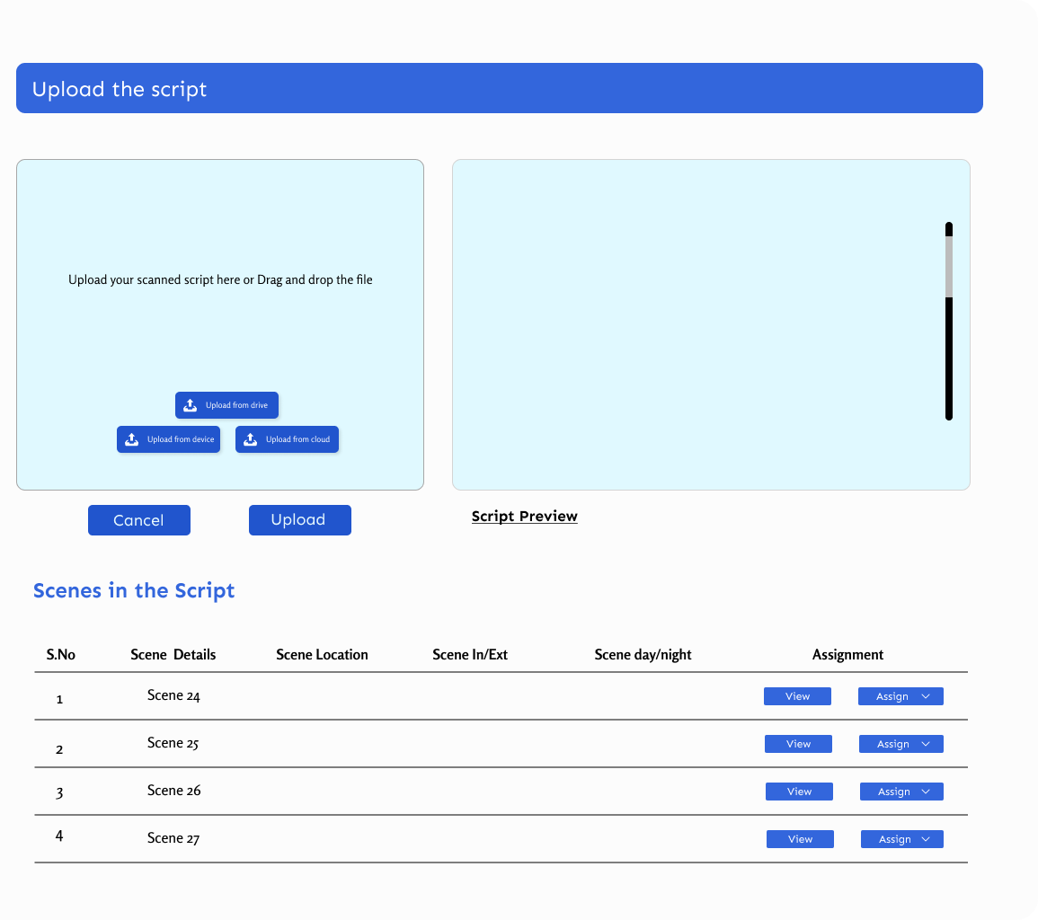
Top Gun
Crew
Upload Script
Setup
Search
Schedule
Reports
Settings
Crew

Slide 55
Director Login
Verify Crew
Upload Script
Assign Scene Setup
Assign Character Setup
Assign Location Setup

Slide 56
Top Gun
Crew
Upload Script
Setup
Search
Schedule
Reports
Settings
Crew

Slide 57
Scenes Setup
19 Open
(28%)
16 Assigned
(23%)
26 Submitted
(37%)
9 Approved
(12%)
Top Gun
Crew
Upload Script
Setup
Setup Board
Assign
Approve
Search
Schedule
Reports
Settings
View
Crew
Character Setup
6 Open
(25%)
3 Assigned
(13%)
7 Submitted
(26%)
9 Approved
(37%)
View
Location Setup
5 Open
(14%)
8 Assigned
(23%)
16 Submitted
(46%)
6 Approved
(17%)
View

Slide 58
Scenes Setup
19 Open
(28%)
16 Assigned
(23%)
26 Submitted
(37%)
9 Approved
(12%)
Top Gun
Crew
Upload Script
Setup
Setup Board
Assign
Approve
Search
Schedule
Reports
Settings
View
Crew
Character Setup
6 Open
(25%)
3 Assigned
(13%)
7 Submitted
(26%)
9 Approved
(37%)
View
Location Setup
5 Open
(14%)
8 Assigned
(23%)
16 Submitted
(46%)
6 Approved
(17%)
View

Slide 59

Scenes Setup
Scene No
Scene Location
Shoot Location
Shoot Time
Screen Time
Status
Assigned To
Assigned Date
Apply
Top Gun
Crew
Upload Script
Setup
Setup Board
Assign
Approve
Search
Schedule
Reports
Settings
Sc.No. | Scene Location | Shoot Location | Shoot Time | Screen Time | Status | Assigned To | Assigned Date
1 | Hero’s House | Ramoji | 48 | 12 | Approved | Raja | 12 Jun 22
2 | Villain Den |  |  |  | Submitted | Deva | 12 Jun 22
3 | Hero Office |  |  |  | Assigned | Krishna | 19 Jun 22
4 | Temple |  |  |  | Open
5 | Park |  |  |  | Assigned | Krishna | 1 Jun 22
6 | Village Road |  |  |  | Submitted | Deva | 19 Jun 22
7 | School | Sarathi | 30 | 2 | Approved | Raja | 1 Jun 22
Crew

Slide 60
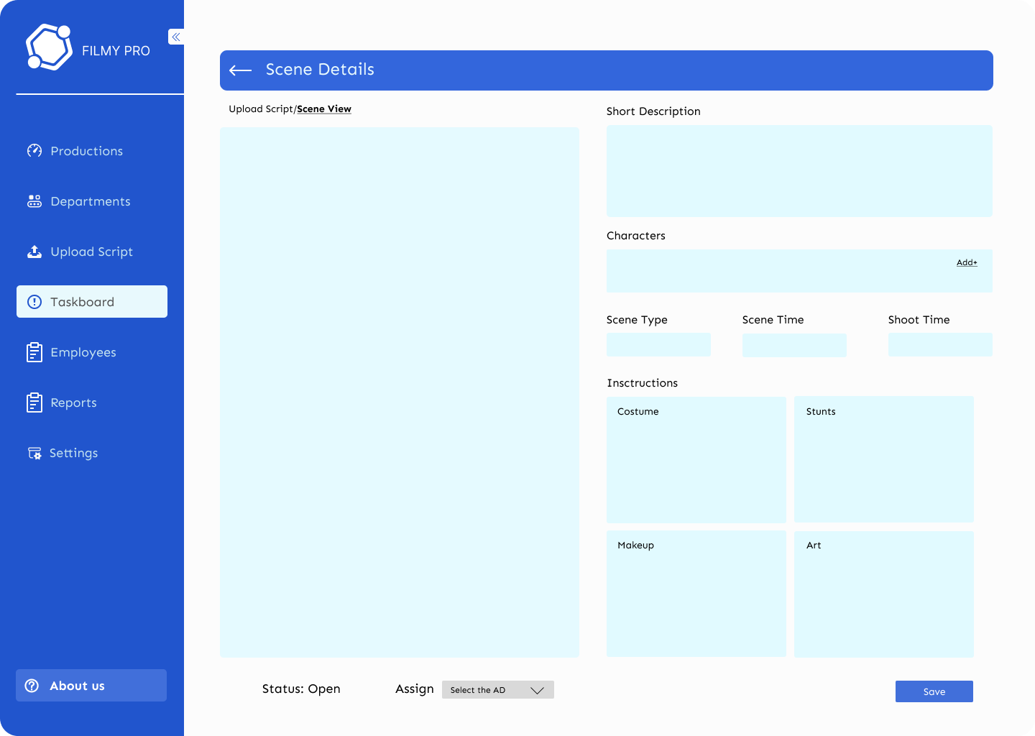
Top Gun
Crew
Upload Script
Setup
Setup Board
Assign
Approve
Search
Schedule
Reports
Settings
Crew

Slide 61
Director Login
Verify Crew
Upload Script
Assign Scene Setup
Assign Character Setup
Assign Location Setup

Slide 62
Scenes Setup
19 Open
(28%)
16 Assigned
(23%)
26 Submitted
(37%)
9 Approved
(12%)
Top Gun
Crew
Upload Script
Setup
Setup Board
Assign
Approve
Search
Schedule
Reports
Settings
View
Crew
Character Setup
6 Open
(25%)
3 Assigned
(13%)
7 Submitted
(26%)
9 Approved
(37%)
View
Location Setup
5 Open
(14%)
8 Assigned
(23%)
16 Submitted
(46%)
6 Approved
(17%)
View

Slide 63
Character Setup
Character Name
Char Type
No of Scenes
Shoot Time
Screen Time
Status
Assigned To
Assigned Date
Apply
Top Gun
Crew
Upload Script
Setup
Setup Board
Assign
Approve
Search
Schedule
Reports
Settings
Character Name | No of Scenes | Character Type | Shoot Time | Screen Time | Status | Assigned To | Assigned Date
Gopi | 38 | Main | 240 | 79 | Approved | Raja | 12 Jun 22
Radha | 29 | Main | 180 | 50 | Submitted | Deva | 12 Jun 22
Bhushan | 18 | Main | 120 | 40 | Assigned | Krishna | 19 Jun 22
Babu | 10 | Side | 100 | 30 | Open
Devi | 10 | Side | 100 | 30 | Assigned | Krishna | 1 Jun 22
Lakshmi | 9 | Character | 90 | 15 | Submitted | Deva | 19 Jun 22
Servant | 6 | Character | 90 | 12 | Approved | Raja | 1 Jun 22
Old Man | 3 | Minor | 60 | 5 | Submitted | Krishna | 12 Jun 22
Crew

Slide 64
Top Gun
Crew
Upload Script
Setup
Setup Board
Assign
Approve
Search
Schedule
Reports
Settings
Crew

Slide 65
Director Login
Verify Crew
Upload Script
Assign Scene Setup
Assign Character Setup
Assign Location Setup

Slide 66
Scenes Setup
19 Open
(28%)
16 Assigned
(23%)
26 Submitted
(37%)
9 Approved
(12%)
Top Gun
Crew
Upload Script
Setup
Setup Board
Assign
Approve
Search
Schedule
Reports
Settings
View
Crew
Character Setup
6 Open
(25%)
3 Assigned
(13%)
7 Submitted
(26%)
9 Approved
(37%)
View
Location Setup
5 Open
(14%)
8 Assigned
(23%)
16 Submitted
(46%)
6 Approved
(17%)
View

Slide 67
Location Setup
Location Name
Location Type
No of Scenes
Shoot Time
Screen Time
Status
Assigned To
Assigned Date
Apply
Top Gun
Crew
Upload Script
Setup
Setup Board
Assign
Approve
Search
Schedule
Reports
Settings
Location Name | No of Scenes | Character Type | Shoot Time | Screen Time | Status | Assigned To | Assigned Date
Office | 38 | Outdoor | 240 | 79 | Approved | Raja | 12 Jun 22
Dhabha | 29 | OD – Set | 180 | 50 | Submitted | Deva | 12 Jun 22
Hero House | 18 | Indoor | 120 | 40 | Assigned | Krishna | 19 Jun 22
School | 10 | Indoor | 100 | 30 | Open
Park | 10 | Outdoor | 100 | 30 | Assigned | Krishna | 1 Jun 22
Villain Den | 9 | ID – Set | 90 | 15 | Submitted | Deva | 19 Jun 22
Hut | 6 | OD – Set | 90 | 12 | Approved | Raja | 1 Jun 22
Road | 3 | Outdoor | 60 | 5 | Submitted | Krishna | 12 Jun 22
Crew

Slide 68
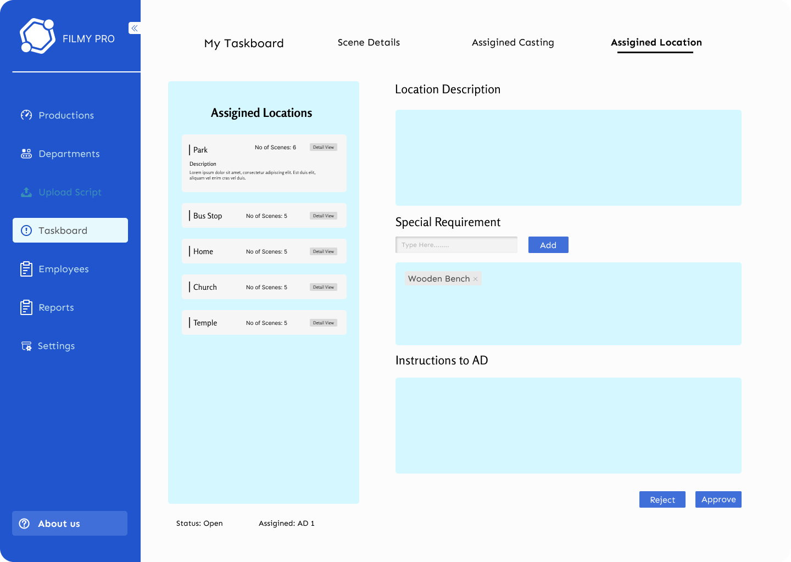
Top Gun
Crew
Upload Script
Setup
Setup Board
Assign
Approve
Search
Schedule
Reports
Settings
Crew

Slide 69
Top Gun
Crew
Upload Script
Setup
Setup Board
Assign
Approve
Search
Schedule
Reports
Settings
Crew

Slide 70
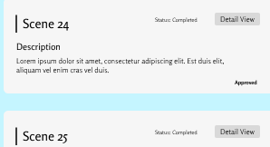
Open Scenes
Open Characters
Open Locations
Top Gun
Crew
Upload Script
Setup
Setup Board
Assign
Approve
Search
Schedule
Reports
Settings
More
More
More
Crew
Assigned Scenes
Assigned Characters
Assigned Locations
More
More
More
Submitted Scenes
Submitted Characters
Submitted Locations
More
More
More

Slide 71
Top Gun
Crew
Upload Script
Setup
Setup Board
Assign
Approve
Search
Schedule
Reports
Settings
Crew

Slide 72
Open Scenes
Open Characters
Open Locations
Top Gun
Crew
Upload Script
Setup
Setup Board
Assign
Approve
Search
Schedule
Reports
Settings
More
More
More
Crew
Assigned Scenes
Assigned Characters
Assigned Locations
More
More
More
Submitted Scenes
Submitted Characters
Submitted Locations
More
More
More

Slide 73
Scenes Setup
Scene No
Scene Location
Shoot Location
Shoot Time
Screen Time
Status
Assigned To
Assigned Date
Apply
Top Gun
Crew
Upload Script
Setup
Setup Board
Assign
Approve
Search
Schedule
Reports
Settings
Sc.No. | Scene Location | Shoot Location | Shoot Time | Screen Time | Status | Assigned To | Assigned Date
1 | Hero’s House |  |  |  | Open
2 | Villain Den |  |  |  | Open
3 | Hero Office |  |  |  | Open
4 | Temple |  |  |  | Open
5 | Park |  |  |  | Open
6 | Village Road |  |  |  | Open
7 | School |  |  |  | Open
Crew

Slide 74
FilmyPro
UI Screens & Workflow
Mod 2.2 AD Setup Input

Slide 75
AD Login
Verify Crew
Input Scene Setup
Input Character Setup
Input Location Setup
Upload Script
Director Login
Dir Scene Setup Approve
Dir Character Setup Approve
Dir Location Setup

Slide 76
AD Login
Verify Crew
Input Scene Setup
Input Character Setup
Input Location Setup
Upload Script
Director Login
Dir Scene Setup Approve
Dir Character Setup Approve
Dir Location Setup

Slide 78
Top Gun

Slide 79
AD Login
Verify Crew
Input Scene Setup
Input Character Setup
Input Location Setup
Upload Script
Director Login
Dir Scene Setup Approve
Dir Character Setup Approve
Dir Location Setup

Slide 80
Top Gun
Crew
Upload Script
Setup
Search
Schedule
Reports
Settings
Crew

Slide 81
Search Crew
Top Gun
Crew
Upload Script
Setup
Search
Schedule
Reports
Settings
Crew
ID | Name | Dept | Sub Dept | Designation
21 | Rama | Direction | Direction | AD2
22 | Krishna | Direction | Casting | AD5
23 | Shiva | Camera | Camera | Focus Puller
25 | Deva | Art | Sets | Assistant
26 | Venu | Art | Paintings | Junior

Slide 82
AD Login
Verify Crew
Input Scene Setup
Input Character Setup
Input Location Setup
Upload Script
Director Login
Dir Scene Setup Approve
Dir Character Setup Approve
Dir Location Setup

Slide 83
Top Gun
Crew
Upload Script
Setup
Search
Schedule
Reports
Settings
Crew

Slide 84
AD Login
Verify Crew
Input Scene Setup
Input Character Setup
Input Location Setup
Upload Script
Director Login
Dir Scene Setup Approve
Dir Character Setup Approve
Dir Location Setup

Slide 85
Top Gun
Crew
Upload Script
Setup
Search
Schedule
Reports
Settings
Crew

Slide 86
Scenes Setup
16 Assigned
(23%)
19 Open
(28%)
26 Submitted
(37%)
9 Approved
(12%)
Top Gun
Crew
Upload Script
Setup
Setup Board
Provide Details
Search
Schedule
Reports
Settings
View
Crew
Character Setup
3 Assigned
(13%)
6 Open
(25%)
7 Submitted
(26%)
9 Approved
(37%)
View
Location Setup
8 Assigned
(23%)
5 Open
(14%)
16 Submitted
(46%)
6 Approved
(17%)
View

Slide 87
Scenes Setup
16 Assigned
(23%)
19 Open
(28%)
26 Submitted
(37%)
9 Approved
(12%)
Top Gun
Crew
Upload Script
Setup
Setup Board
Provide Details
Search
Schedule
Reports
Settings
View
Crew
Character Setup
3 Assigned
(13%)
6 Open
(25%)
7 Submitted
(26%)
9 Approved
(37%)
View
Location Setup
8 Assigned
(23%)
5 Open
(14%)
16 Submitted
(46%)
6 Approved
(17%)
View

Slide 88
Scenes Setup
Scene No
Scene Location
Shoot Location
Shoot Time
Screen Time
Status
Assigned To
Assigned Date
Apply
Top Gun
Crew
Upload Script
Setup
Setup Board
Provide Details
Search
Schedule
Reports
Settings
Sc.No. | Scene Location | Shoot Location | Shoot Time | Screen Time | Status | Assigned To | Assigned Date
1 | Hero’s House | Ramoji | 48 | 12 | Approved | Raja | 12 Jun 22
2 | Villain Den |  |  |  | Assigned | Raja | 12 Jun 22
3 | Hero Office |  |  |  | Assigned | Raja | 19 Jun 22
4 | Temple |  |  |  | Assigned | Raja
5 | School | Sarathi | 30 | 2 | Approved | Raja | 1 Jun 22
Crew

Slide 89
Top Gun
Crew
Upload Script
Setup
Setup Board
Provide Details
Search
Schedule
Reports
Settings
Crew
Submit

Slide 90
AD Login
Verify Crew
Input Scene Setup
Input Character Setup
Input Location Setup
Upload Script
Director Login
Dir Scene Setup Approve
Dir Character Setup Approve
Dir Location Setup

Slide 91
Scenes Setup
19 Open
(28%)
16 Assigned
(23%)
26 Submitted
(37%)
9 Approved
(12%)
Top Gun
Crew
Upload Script
Setup
Setup Board
Provide Details
Search
Schedule
Reports
Settings
View
Crew
Character Setup
6 Open
(25%)
3 Assigned
(13%)
7 Submitted
(26%)
9 Approved
(37%)
View
Location Setup
5 Open
(14%)
8 Assigned
(23%)
16 Submitted
(46%)
6 Approved
(17%)
View

Slide 92
Character Setup
Character Name
Char Type
No of Scenes
Shoot Time
Screen Time
Status
Assigned To
Assigned Date
Apply
Top Gun
Crew
Upload Script
Setup
Setup Board
Provide Details
Search
Schedule
Reports
Settings
Character Name | No of Scenes | Character Type | Shoot Time | Screen Time | Status | Assigned To | Assigned Date
Gopi | 38 | Main | 240 | 79 | Approved | Raja | 12 Jun 22
Radha | 29 | Main | 180 | 50 | Submitted | Raja | 12 Jun 22
Bhushan | 18 | Main | 120 | 40 | Assigned | Raja | 19 Jun 22
Babu | 10 | Side | 100 | 30 | Assigned | Raja
Devi | 10 | Side | 100 | 30 | Assigned | Raja | 1 Jun 22
Crew

Slide 93
Top Gun
Crew
Upload Script
Setup
Setup Board
Provide Details
Search
Schedule
Reports
Settings
Crew
Submit

Slide 94
AD Login
Verify Crew
Input Scene Setup
Input Character Setup
Input Location Setup
Upload Script
Director Login
Dir Scene Setup Approve
Dir Character Setup Approve
Dir Location Setup

Slide 95
Scenes Setup
19 Open
(28%)
16 Assigned
(23%)
26 Submitted
(37%)
9 Approved
(12%)
Top Gun
Crew
Upload Script
Setup
Setup Board
Provide Details
Search
Schedule
Reports
Settings
View
Crew
Character Setup
6 Open
(25%)
3 Assigned
(13%)
7 Submitted
(26%)
9 Approved
(37%)
View
Location Setup
5 Open
(14%)
8 Assigned
(23%)
16 Submitted
(46%)
6 Approved
(17%)
View

Slide 96
Location Setup
Location Name
Location Type
No of Scenes
Shoot Time
Screen Time
Status
Assigned To
Assigned Date
Apply
Top Gun
Crew
Upload Script
Setup
Setup Board
Provide Details
Search
Schedule
Reports
Settings
Location Name | No of Scenes | Character Type | Shoot Time | Screen Time | Status | Assigned To | Assigned Date
Office | 38 | Outdoor | 240 | 79 | Approved | Raja | 12 Jun 22
Dhabha | 29 | OD – Set | 180 | 50 | Submitted | Raja | 12 Jun 22
Hero House | 18 | Indoor | 120 | 40 | Assigned | Raja | 19 Jun 22
School | 10 | Indoor | 100 | 30 | Assigned | Raja | 19 Jun 22
Park | 10 | Outdoor | 100 | 30 | Assigned | Raja | 1 Jun 22
Villain Den | 9 | ID – Set | 90 | 15 | Approved | Deva | 19 Jun 22
Crew

Slide 97
Top Gun
Crew
Upload Script
Setup
Setup Board
Provide Details
Search
Schedule
Reports
Settings
Crew
Submit

Slide 98
Top Gun
Crew
Upload Script
Setup
Setup Board
Provide Details
Search
Schedule
Reports
Settings
Crew

Slide 99
Assigned Scenes
Assigned Characters
Assigned Locations
Top Gun
Crew
Upload Script
Setup
Setup Board
Provide Details
Search
Schedule
Reports
Settings
More
More
More
Crew
Submitted Scenes
Submitted Characters
Submitted Locations
More
More
More
Approved Scenes
Approved Characters
Approved Locations
More
More
More

Slide 100
Top Gun
Crew
Upload Script
Setup
Setup Board
Provide Details
Search
Schedule
Reports
Settings
Crew
Submit

Slide 101
FilmyPro
UI Screens & Workflow
Mod 2.3: Director Setup Approve

Slide 102
AD Login
Verify Crew
Input Scene Setup
Input Character Setup
Input Location Setup
Upload Script
Director Login
Dir Scene Setup Approve
Dir Character Setup Approve
Dir Location Setup

Slide 104
Top Gun

Slide 105
AD Login
Verify Crew
Input Scene Setup
Input Character Setup
Input Location Setup
Upload Script
Director Login
Dir Scene Setup Approve
Dir Character Setup Approve
Dir Location Setup

Slide 106
Top Gun
Crew
Upload Script
Setup
Search
Schedule
Reports
Settings
Crew

Slide 107
Scenes Setup
19 Open
(28%)
16 Assigned
(23%)
26 Submitted
(37%)
9 Approved
(12%)
Top Gun
Crew
Upload Script
Setup
Setup Board
Assign
Approve
Search
Schedule
Reports
Settings
View
Crew
Character Setup
6 Open
(25%)
3 Assigned
(13%)
7 Submitted
(26%)
9 Approved
(37%)
View
Location Setup
5 Open
(14%)
8 Assigned
(23%)
16 Submitted
(46%)
6 Approved
(17%)
View

Slide 108
Scenes Setup
19 Open
(28%)
16 Assigned
(23%)
26 Submitted
(37%)
9 Approved
(12%)
Top Gun
Crew
Upload Script
Setup
Setup Board
Assign
Approve
Search
Schedule
Reports
Settings
View
Crew
Character Setup
6 Open
(25%)
3 Assigned
(13%)
7 Submitted
(26%)
9 Approved
(37%)
View
Location Setup
5 Open
(14%)
8 Assigned
(23%)
16 Submitted
(46%)
6 Approved
(17%)
View

Slide 109
Scenes Setup
Scene No
Scene Location
Shoot Location
Shoot Time
Screen Time
Status
Assigned To
Assigned Date
Apply
Top Gun
Crew
Upload Script
Setup
Setup Board
Assign
Approve
Search
Schedule
Reports
Settings
Sc.No. | Scene Location | Shoot Location | Shoot Time | Screen Time | Status | Assigned To | Assigned Date
1 | Hero’s House | Ramoji | 48 | 12 | Approved | Raja | 12 Jun 22
2 | Villain Den |  |  |  | Submitted | Deva | 12 Jun 22
3 | Hero Office |  |  |  | Assigned | Krishna | 19 Jun 22
4 | Temple |  |  |  | Open
5 | Park |  |  |  | Assigned | Krishna | 1 Jun 22
6 | Village Road |  |  |  | Submitted | Deva | 19 Jun 22
7 | School | Sarathi | 30 | 2 | Approved | Raja | 1 Jun 22
Crew

Slide 110
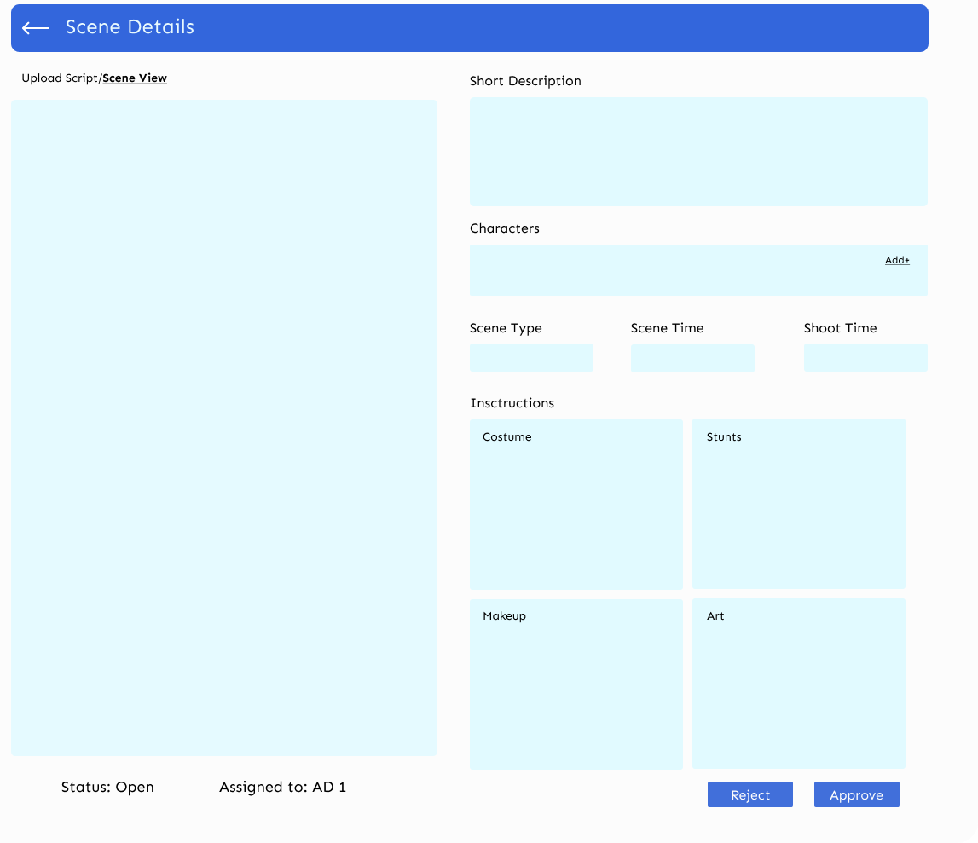
Top Gun
Crew
Upload Script
Setup
Setup Board
Assign
Approve
Search
Schedule
Reports
Settings
Crew

Slide 111
AD Login
Verify Crew
Input Scene Setup
Input Character Setup
Input Location Setup
Upload Script
Director Login
Dir Scene Setup Approve
Dir Character Setup Approve
Dir Location Setup

Slide 112
Character Setup
Character Name
Char Type
No of Scenes
Shoot Time
Screen Time
Status
Assigned To
Assigned Date
Apply
Top Gun
Crew
Upload Script
Setup
Setup Board
Assign
Approve
Search
Schedule
Reports
Settings
Character Name | No of Scenes | Character Type | Shoot Time | Screen Time | Status | Assigned To | Assigned Date
Gopi | 38 | Main | 240 | 79 | Approved | Raja | 12 Jun 22
Radha | 29 | Main | 180 | 50 | Submitted | Deva | 12 Jun 22
Bhushan | 18 | Main | 120 | 40 | Assigned | Krishna | 19 Jun 22
Babu | 10 | Side | 100 | 30 | Open
Devi | 10 | Side | 100 | 30 | Assigned | Krishna | 1 Jun 22
Lakshmi | 9 | Character | 90 | 15 | Submitted | Deva | 19 Jun 22
Servant | 6 | Character | 90 | 12 | Approved | Raja | 1 Jun 22
Old Man | 3 | Minor | 60 | 5 | Submitted | Krishna | 12 Jun 22
Crew

Slide 113
Top Gun
Crew
Upload Script
Setup
Setup Board
Assign
Approve
Search
Schedule
Reports
Settings
Crew

Slide 114
AD Login
Verify Crew
Input Scene Setup
Input Character Setup
Input Location Setup
Upload Script
Director Login
Dir Scene Setup Approve
Dir Character Setup Approve
Dir Location Setup

Slide 115
Location Setup
Location Name
Location Type
No of Scenes
Shoot Time
Screen Time
Status
Assigned To
Assigned Date
Apply
Top Gun
Crew
Upload Script
Setup
Setup Board
Assign
Approve
Search
Schedule
Reports
Settings
Location Name | No of Scenes | Character Type | Shoot Time | Screen Time | Status | Assigned To | Assigned Date
Office | 38 | Outdoor | 240 | 79 | Approved | Raja | 12 Jun 22
Dhabha | 29 | OD – Set | 180 | 50 | Submitted | Deva | 12 Jun 22
Hero House | 18 | Indoor | 120 | 40 | Assigned | Krishna | 19 Jun 22
School | 10 | Indoor | 100 | 30 | Open
Park | 10 | Outdoor | 100 | 30 | Assigned | Krishna | 1 Jun 22
Villain Den | 9 | ID – Set | 90 | 15 | Submitted | Deva | 19 Jun 22
Hut | 6 | OD – Set | 90 | 12 | Approved | Raja | 1 Jun 22
Road | 3 | Outdoor | 60 | 5 | Submitted | Krishna | 12 Jun 22
Crew

Slide 116
Top Gun
Crew
Upload Script
Setup
Setup Board
Assign
Approve
Search
Schedule
Reports
Settings
Crew

Slide 117
Top Gun
Crew
Upload Script
Setup
Setup Board
Assign
Approve
Search
Schedule
Reports
Settings
Crew

Slide 118
Submitted Scenes
Submitted Characters
Submitted Locations
Top Gun
Crew
Upload Script
Setup
Setup Board
Assign
Approve
Search
Schedule
Reports
Settings
More
More
More
Crew
Approved Scenes
Approved Characters
Approved Locations
More
More
More

Slide 119
Top Gun
Crew
Upload Script
Setup
Setup Board
Assign
Approve
Search
Schedule
Reports
Settings
Crew

Slide 120
Submitted Scenes
Submitted Characters
Submitted Locations
Top Gun
Crew
Upload Script
Setup
Setup Board
Assign
Approve
Search
Schedule
Reports
Settings
More
More
More
Crew
Approved Scenes
Approved Characters
Approved Locations
More
More
More

Slide 121
Location Setup
Location Name
Location Type
No of Scenes
Shoot Time
Screen Time
Status
Assigned To
Assigned Date
Apply
Top Gun
Crew
Upload Script
Setup
Setup Board
Assign
Approve
Search
Schedule
Reports
Settings
Location Name | No of Scenes | Character Type | Shoot Time | Screen Time | Status | Assigned To | Assigned Date
Office | 38 | Outdoor | 240 | 79 | Submitted | Raja | 12 Jun 22
Dhabha | 29 | OD – Set | 180 | 50 | Submitted | Deva | 12 Jun 22
Hero House | 18 | Indoor | 120 | 40 | Submitted | Krishna | 19 Jun 22
School | 10 | Indoor | 100 | 30 | Submitted | Krishna | 12 Jun 22
Park | 10 | Outdoor | 100 | 30 | Submitted | Krishna | 1 Jun 22
Villain Den | 9 | ID – Set | 90 | 15 | Submitted | Deva | 19 Jun 22
Hut | 6 | OD – Set | 90 | 12 | Submitted | Raja | 1 Jun 22
Road | 3 | Outdoor | 60 | 5 | Submitted | Krishna | 12 Jun 22
Crew

Slide 122
FilmyPro
UI Screens & Workflow
Mod 3.1: Director Search Assign

Slide 123
Director Login
Assign Character
AD Login
Search Actor
Search Location
Assign Location
Director Login
Approve Actor
Approve Location

Slide 124
Director Login
Assign Character
AD Login
Search Actor
Search Location
Assign Location
Director Login
Approve Actor
Approve Location

Slide 126
Top Gun

Slide 127
Director Login
Assign Character
AD Login
Search Actor
Search Location
Assign Location
Director Login
Approve Actor
Approve Location

Slide 128
Top Gun
Crew
Upload Script
Setup
Search
Schedule
Reports
Settings
Crew

Slide 129

Gopi
Radha
Bhushan
Main
M/28
Main
F/25
Main
M/35
Top Gun
Description
Description
Description
Crew
Upload Script
Setup
Search
Assign Character
Assign Location
Approve Charactr
Approve Location
Schedule
Reports
Settings
Key Features
Key Features
Key Features
Crew
More
Select
More
Select
More
Select
Babu
Devi
Lakshmi
Side
M/25
Side
F/25
Character
F/40
Description
Description
Description
Key Features
Key Features
Key Features
More
Select
More
Select
More
Select
Assign

Slide 130
Director Login
Assign Character
AD Login
Search Actor
Search Location
Assign Location
Director Login
Approve Actor
Approve Location

Slide 131
Top Gun
Crew
Upload Script
Setup
Search
Assign Character
Assign Location
Approve Charactr
Approve Location
Schedule
Reports
Settings
Crew

Slide 132
Office
Dhabha
Hero’s House
Total Scenes
Shoot Time
Screen Time
Total Scenes
Shoot Time
Screen Time
Total Scenes
Shoot Time
Screen Time
Top Gun
Description
Description
Description
Crew
Upload Script
Setup
Search
Assign Character
Assign Location
Approve Charactr
Approve Location
Schedule
Reports
Settings
Requirements
Requirements
Requirements
Crew
More
Select
More
Select
More
Select
School
Park
Villain’s Den
Total Scenes
Shoot Time
Screen Time
Total Scenes
Shoot Time
Screen Time
Total Scenes
Shoot Time
Screen Time
Description
Description
Description
Requirements
Requirements
Requirements
More
Select
More
Select
More
Select
Assign

Slide 133
FilmyPro
UI Screens & Workflow
Mod 3.2: AD Search Input

Slide 134
Director Login
Assign Character
AD Login
Search Actor
Search Location
Assign Location
Director Login
Approve Actor
Approve Location

Slide 136
Top Gun

Slide 137
Director Login
Assign Character
AD Login
Search Actor
Search Location
Assign Location
Director Login
Approve Actor
Approve Location

Slide 138
Top Gun
Crew
Upload Script
Setup
Search
Schedule
Reports
Settings
Crew

Slide 139
Gopi
Radha
Bhushan
Main
M/28
Main
F/25
Main
M/35
Top Gun
Description
Description
Description
Crew
Upload Script
Setup
Search
Search Character
Search Location
Schedule
Reports
Settings
Key Features
Key Features
Key Features
Crew
Select
Select
Select
Babu
Devi
Lakshmi
Side
M/25
Side
F/25
Character
F/40
Description
Description
Description
Key Features
Key Features
Key Features
Select
Select
Select
Casting Call
Search Database
Add Actor

Slide 140
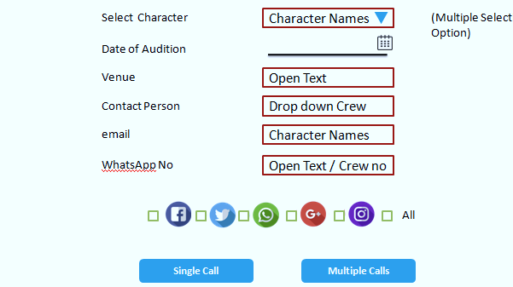
Search Character / Casting Call
Top Gun
Crew
Upload Script
Setup
Search
Search Character
Search Location
Schedule
Reports
Settings
Crew
Generate

Slide 141

Search Character / Casting Call
Top Gun
Crew
Upload Script
Setup
Search
Search Character
Search Location
Schedule
Reports
Settings
Crew
Generate
Download

Slide 142
Gopi
Radha
Bhushan
Main
M/28
Main
F/25
Main
M/35
Top Gun
Description
Description
Description
Crew
Upload Script
Setup
Search
Search Character
Search Location
Schedule
Reports
Settings
Key Features
Key Features
Key Features
Crew
Select
Select
Select
Babu
Devi
Lakshmi
Side
M/25
Side
F/25
Character
F/40
Description
Description
Description
Key Features
Key Features
Key Features
Select
Select
Select
Casting Call
Search Database
Add Actor

Slide 143
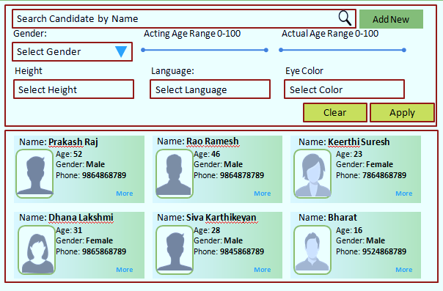
Search Character / Database
Top Gun
Crew
Upload Script
Setup
Search
Search Character
Search Location
Schedule
Reports
Settings
Crew

Slide 144
Gopi
Radha
Bhushan
Main
M/28
Main
F/25
Main
M/35
Top Gun
Description
Description
Description
Crew
Upload Script
Setup
Search
Search Character
Search Location
Schedule
Reports
Settings
Key Features
Key Features
Key Features
Crew
Select
Select
Select
Babu
Devi
Lakshmi
Side
M/25
Side
F/25
Character
F/40
Description
Description
Description
Key Features
Key Features
Key Features
Select
Select
Select
Casting Call
Search Database
Add Actor

Slide 145
Add Actor
Top Gun
Name:
Crew
Upload Script
Setup
Search
Search Character
Search Location
Schedule
Reports
Settings
Add Photo
Acting Age: Height: Gender
Hair Colour: Eye Colour: Languages
Email Phone: Performing Arts
Athletics Dance & Music
Address
Film Experience:
Roles Films Role
Crew
Submit

Slide 146
Director Login
Assign Character
AD Login
Search Actor
Search Location
Assign Location
Director Login
Approve Actor
Approve Location

Slide 147
Top Gun
Crew
Upload Script
Setup
Search
Search Character
Search Location
Schedule
Reports
Settings
Crew

Slide 148
Office
Dhabha
Hero’s House
Total Scenes
Shoot Time
Screen Time
Total Scenes
Shoot Time
Screen Time
Total Scenes
Shoot Time
Screen Time
Top Gun
Description
Description
Description
Crew
Upload Script
Setup
Search
Search Character
Search Location
Schedule
Reports
Settings
Requirements
Requirements
Requirements
Crew
More
Select
More
Select
More
Select
School
Park
Villain’s Den
Total Scenes
Shoot Time
Screen Time
Total Scenes
Shoot Time
Screen Time
Total Scenes
Shoot Time
Screen Time
Description
Description
Description
Requirements
Requirements
Requirements
More
Select
More
Select
More
Select
Search Database
Add Location

Slide 149
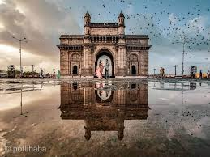

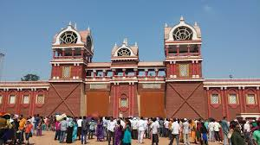
Search Location / Database
Search Filters
Top Gun
Crew
Upload Script
Setup
Search
Search Character
Search Location
Schedule
Reports
Settings
By City +
By Budget +
Gateway of India
National Park
Ramoji Film City
Crew
Mumbai
London
Hyderabad
By Latest +
Select More
Select More
Select More

Slide 150
Office
Dhabha
Hero’s House
Total Scenes
Shoot Time
Screen Time
Total Scenes
Shoot Time
Screen Time
Total Scenes
Shoot Time
Screen Time
Top Gun
Description
Description
Description
Crew
Upload Script
Setup
Search
Search Character
Search Location
Schedule
Reports
Settings
Requirements
Requirements
Requirements
Crew
More
Select
More
Select
More
Select
School
Park
Villain’s Den
Total Scenes
Shoot Time
Screen Time
Total Scenes
Shoot Time
Screen Time
Total Scenes
Shoot Time
Screen Time
Description
Description
Description
Requirements
Requirements
Requirements
More
Select
More
Select
More
Select
Search Database
Add Location

Slide 151
Add Location
Top Gun
Name of location:
Crew
Upload Script
Setup
Search
Search Character
Search Location
Schedule
Reports
Settings
Add Photos
Location Type:
Category: Specification:
Budget / Day: Country:
Address:
Owner Details:
Previous Films:
Permissions:
Crew
Submit

Slide 152
FilmyPro
UI Screens & Workflow
Mod 3.3: Director Search Approve

Slide 153
Director Login
Assign Character
AD Login
Search Actor
Search Location
Assign Location
Director Login
Approve Actor
Approve Location

Slide 155
Top Gun

Slide 156
Director Login
Assign Character
AD Login
Search Actor
Search Location
Assign Location
Director Login
Approve Actor
Approve Location

Slide 157
Top Gun
Crew
Upload Script
Setup
Search
Schedule
Reports
Settings
Crew

Slide 158
Top Gun
Crew
Upload Script
Setup
Search
Search Character
Search Location
Approve Charactr
Approve Location
Schedule
Reports
Settings
Crew

Slide 159
Gopi
Radha
Bhushan
Main
M/28
Main
F/25
Main
M/35
Top Gun
Description
Description
Description
Crew
Upload Script
Setup
Search
Search Character
Search Location
Approve Charactr
Approve Location
Schedule
Reports
Settings
Key Features
Key Features
Key Features
Crew
Select
Select
Select
Babu
Devi
Lakshmi
Side
M/25
Side
F/25
Character
F/40
Description
Description
Description
Key Features
Key Features
Key Features
Select
Select
Select

Slide 160

Approve Actor
Radha
Keerthi Suresh
Top Gun
Crew
Upload Script
Setup
Search
Search Character
Search Location
Approve Charactr
Approve Location
Schedule
Reports
Settings
Description
Acting Age: Height: Gender
Hair Colour: Eye Colour: Languages
Email Phone: Performing Arts
Athletics Dance & Music
Address
Film Experience:
Roles Films Role
Crew
Age
Hair
Height
Weight
Distinguishing Features
No of Scenes
Reject
Re-Assign
Cancel
Hold
Approve

Slide 161
Director Login
Assign Character
AD Login
Search Actor
Search Location
Assign Location
Director Login
Approve Actor
Approve Location

Slide 162
Top Gun
Crew
Upload Script
Setup
Search
Search Character
Search Location
Approve Charactr
Approve Location
Schedule
Reports
Settings
Crew

Slide 163
Office
Dhabha
Hero’s House
Total Scenes
Shoot Time
Screen Time
Total Scenes
Shoot Time
Screen Time
Total Scenes
Shoot Time
Screen Time
Top Gun
Description
Description
Description
Crew
Upload Script
Setup
Search
Search Character
Search Location
Schedule
Reports
Settings
Requirements
Requirements
Requirements
Crew
More
Select
More
Select
More
Select
School
Park
Villain’s Den
Total Scenes
Shoot Time
Screen Time
Total Scenes
Shoot Time
Screen Time
Total Scenes
Shoot Time
Screen Time
Description
Description
Description
Requirements
Requirements
Requirements
More
Select
More
Select
More
Select

Slide 164
Approve Location
Office
Ramoji Film City
Top Gun
Crew
Upload Script
Setup
Search
Search Character
Search Location
Approve Charactr
Approve Location
Schedule
Reports
Settings
Description
Location Type
Permission
Category
Crew
Special Requirement
more
Specification
Budget / Day
S no | Requirement | Priority
1 | TV | Required
2 | Fridge | Optional
Area
Country
State / Province
Owner Details
No of Scenes
Previous Films
Reject
Re-Assign
Cancel
Hold
Approve

Slide 165
FilmyPro
UI Screens & Workflow
Mod 4.1: AD Schedule Input Dates

Slide 166
AD Login
Character Dates
Location Dates
Director Login
Define Criticality
Schedule

Slide 167
AD Login
Character Dates
Location Dates
Director Login
Define Criticality
Schedule

Slide 169
Top Gun

Slide 170
AD Login
Character Dates
Location Dates
Director Login
Define Criticality
Schedule

Slide 171
Top Gun
Crew
Upload Script
Setup
Search
Schedule
Reports
Settings
Crew

Slide 172
Top Gun
Crew
Upload Script
Setup
Search
Schedule
Actor Dates
Location Dates
Reports
Settings
Crew

Slide 173
Gopi: Nani
Radha – Kirthi Suresh
Bhushan - Satyadev
Main
M/28
Main
F/25
Main
M/35
Top Gun
Description
Description
Description
Crew
Upload Script
Setup
Search
Schedule
Actor Dates
Location Dates
Reports
Settings
Key Features
Key Features
Key Features
Crew
Status: Approved
Select
Status: Approved
Select
Status: Approved
Select
Babu - Subbaraju
Devi: Hema
Lakshmi: Roopa
Side
M/25
Side
F/25
Character
F/40
Description
Description
Description
Key Features
Key Features
Key Features
Status: Approved
Select
Status: Rejected
Select
Status: Pending
Select

Slide 174
Actor Dates
Status: Approved
Radha
Keerthi Suresh
Top Gun
Crew
Upload Script
Setup
Search
Schedule
Actor Dates
Location Dates
Reports
Settings
Description
Acting Age: Height: Gender
Hair Colour: Eye Colour: Languages
Email Phone: Performing Arts
Athletics Dance & Music
Address
Film Experience:
Roles Films Role
Crew
Age
Hair
Height
Weight
Distinguishing Features
No of Scenes
Add dates

Slide 175
Actor Dates
Status: Approved
Radha
Keerthi Suresh
Top Gun
Crew
Upload Script
Setup
Search
Schedule
Actor Dates
Location Dates
Reports
Settings
Description
Acting Age: Height: Gender
Hair Colour: Eye Colour: Languages
Email Phone: Performing Arts
Athletics Dance & Music
Address
Film Experience:
Roles Films Role
Crew
Age
Kirti Suresh Available Dates
Hair
Height
No of Scenes
Weight
Estimated Time
Distinguishing Features
Criticality
No of Scenes
From Date
To Date
Flexible Yes / No
Add dates
More dates
Send for Schedule

Slide 176
AD Login
Character Dates
Location Dates
Director Login
Define Criticality
Schedule

Slide 177
Top Gun
Crew
Upload Script
Setup
Search
Schedule
Actor Dates
Location Dates
Reports
Settings
Crew

Slide 178
Office
Dhabha
Hero’s House
Total Scenes
Shoot Time
Screen Time
Total Scenes
Shoot Time
Screen Time
Total Scenes
Shoot Time
Screen Time
Top Gun
Description
Description
Description
Crew
Upload Script
Setup
Search
Schedule
Actor Dates
Location Dates
Reports
Settings
Requirements
Requirements
Requirements
Crew
More
Select
More
Select
More
Select
School
Park
Villain’s Den
Total Scenes
Shoot Time
Screen Time
Total Scenes
Shoot Time
Screen Time
Total Scenes
Shoot Time
Screen Time
Description
Description
Description
Requirements
Requirements
Requirements
More
Select
More
Select
More
Select

Slide 179
Location Dates
Status: Approved
Office
Ramoji Film City
Top Gun
Crew
Upload Script
Setup
Search
Schedule
Actor Dates
Location Dates
Reports
Settings
Description
Location Type
Permission
Category
Crew
Special Requirement
more
Specification
Budget / Day
S no | Requirement | Priority
1 | TV | Required
2 | Fridge | Optional
Area
Country
State / Province
Owner Details
No of Scenes
Previous Films
Add dates

Slide 180
Location Dates
Status: Approved
Office
Ramoji Film City
Top Gun
Crew
Upload Script
Setup
Search
Schedule
Actor Dates
Location Dates
Reports
Settings
Description
Location Type
Permission
Category
Crew
Special Requirement
more
Specification
Ramoji Film City Dates
Budget / Day
S no | Requirement | Priority
1 | TV | Required
2 | Fridge | Optional
No of Scenes
Area
Estimated Time
Country
State / Province
Criticality
Owner Details
No of Scenes
Previous Films
From Date
To Date
Flexible Yes / No
Add dates
More dates
Send for Schedule

Slide 181
FilmyPro
UI Screens & Workflow
Mod 4.2: Director Schedule

Slide 182
AD Login
Character Dates
Location Dates
Director Login
Define Criticality
Schedule

Slide 184
Top Gun

Slide 185
AD Login
Character Dates
Location Dates
Director Login
Define Criticality
Schedule

Slide 186
Top Gun
Crew
Upload Script
Setup
Search
Schedule
Reports
Settings
Crew

Slide 187
Character | Actor | Scenes | Shoot Days | Dates | Criticality
Gopi | Nani | 38 | 80 | 112
Radha | Kirthi | 29 | 60 | 90
Bhushan | Satyadev | 18 | 40 | 60
Babu | Subbaraju | 10 | 30 | 100
Devi | Hema | 10 | 30 | 90
Lakshmi | Roopa | 9 | 15 | 90
Servant | Raju | 6 | 12 | 30
Oldman | Samba | 3 | 5 | 15
Top Gun
Crew
Upload Script
Setup
Search
Schedule
Reports
Settings
Crew
Schedule

Slide 188
AD Login
Character Dates
Location Dates
Director Login
Define Criticality
Schedule

Slide 189

SCHEDULE 1: RAMOJI FILM CITY: From: 12 Aug 22 To: 18 Sept 22
Date S.No. SCENE HEADING Estd Time Day Pages
Top Gun
12 Aug 22 48 INT. TEMPLE – NIGHT 2 1 47
Crew
Upload Script
Setup
Search
Schedule
Reports
Settings
13 Aug 22 48 INT. TEMPLE – NIGHT 2 2 48
Crew
14 Aug 22 41, 43 INT. BANK – NIGHT 2 1 40, 44
16 Aug 22 47 INT. BANK – NIGHT 2 1 40, 44
More
SCHEDULE 2: Vizag From: 22 Sept 22 To: 29 Sept 22
Date S.No. SCENE HEADING Estd Time Day Pages
22 Sept 22 50,51 INT. DEVA LODGE– NIGHT 1 1 36
24 Sep 22 42,45 EXT. TAXI STAND – NIGHT 2 1 43,50
More

